Slide 1
THE JUNIOR LIVESTOCK PROGRAM
FITTING AND GROOMING BASICS
KIPP BROWN
Extension Livestock coordinator
Department of animal and dairy sciences

Slide 2
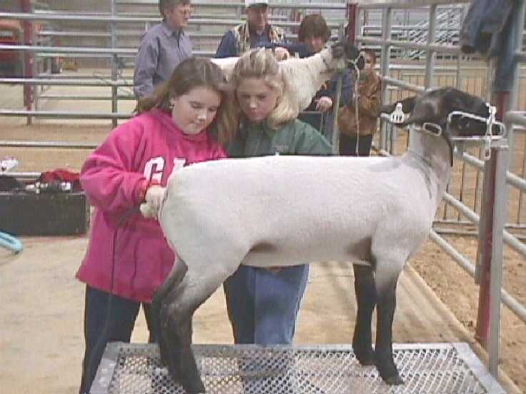
LIVESTOCK CLIPPING AND TECHNIQUES
Why do we clip livestock?
  To enhance the appearance of animals
  Satisfy rules of the show
What species do we clip?
  Market steers, hogs, lambs and goats
  Breeding cattle/goats
  Dairy cattle/goats
  Horses

Slide 3
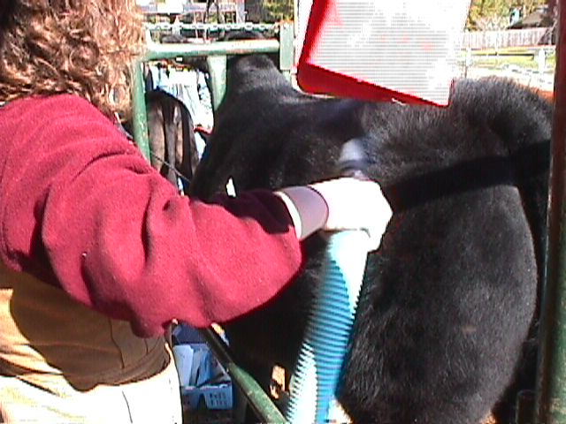
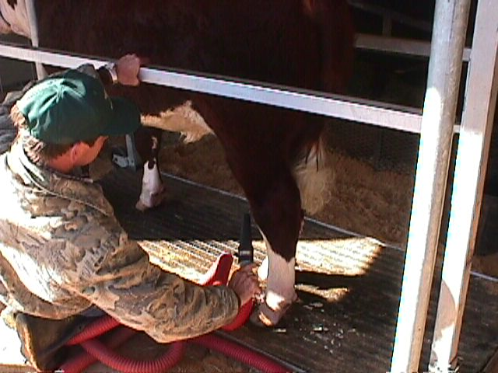
LIVESTOCK CLIPPING AND TECHNIQUES
What do we need to clip?
  Hair products to train hair and enhance skin
  Clippers, blades, blower, etc.
  Stand, chute, combs, cards, etc.
How do we learn to clip?
  Videos, publications
  watching others
  PRACTICE!

Slide 4
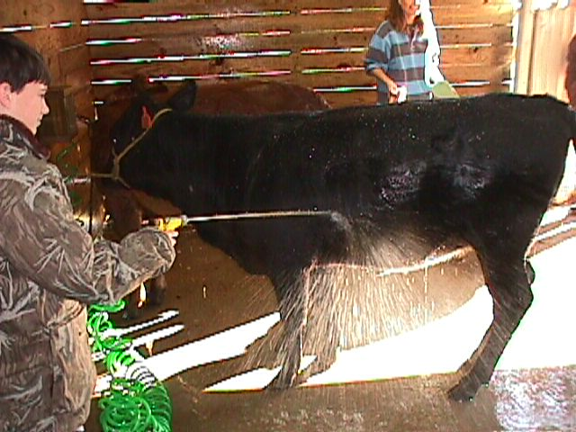
BASICS!
Buy clippers that will work for all species.
Keep hair conditioned with quality grooming products prior to clipping
Do not wash lambs or goats any more than necessary
Start with a clean animal
Make sure all soap is
Removed from hair or wool

Slide 5
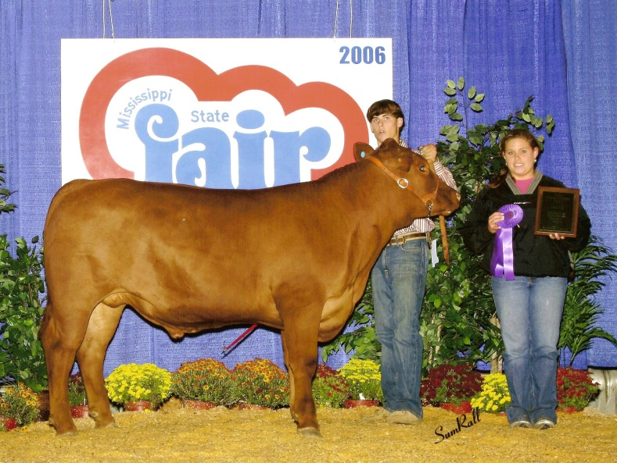
SLICK SHEAR MARKET STEERS
Wash and condition hair before clipping
Clip everything from the hoof up with fine blades leaving hair shorter than ¼ inch
Use a small torch to get into areas clippers can’t such as pasterns, brisket and twist
Bob the tail square
Watch for kicking!

Slide 6
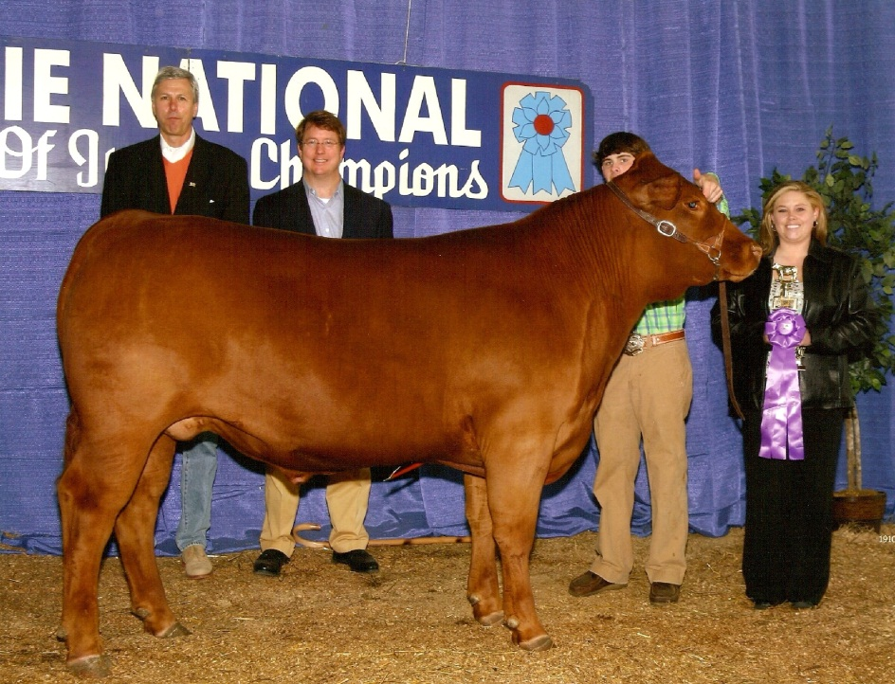
SLICK SHEAR MARKET STEERS
Spray with conditioner every day to keep hair soft and skin from cracking
Clip at least one month out and then again at least a week prior to a major show
Use a modified horse blanket
to help maintain condition
And finish in cold weather

Slide 7
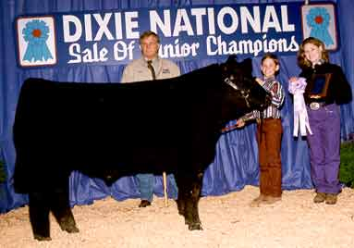
HAIR STEERS/BREEDING CATTLE
Hair must be broke and ready to clip
Wash and dry completely before clipping
Clip a little at a time
Do not get in a hurry!
Enlist the help of a seasoned volunteer to
work with exhibitors in your county
Go online and search for “clipping show cattle”
Videos and pictures!

Slide 8
MARKET HOGS
Wash and clean every part of the hog including the ears and ear tags
Clip the entire hog (including the face) with medium blades
Usually can be done sitting in the pen without using a snare
Clip at home, not at the show

Slide 9
MARKET LAMBS
Wash and clean the lamb with a mild soap to remove the lanolin from the wool
Be sure to clean in the pockets high between the rear legs and under the breast plate
Get out all dirt and rinse well to remove soap
Slick shear with medium or fine blades (depending on fat thickness) from the knee and hock up including the head and face

Slide 10
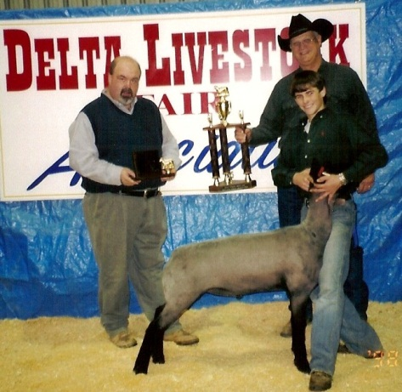
MARKET LAMBS
Always card leg wool down and use blocking blades to square the legs
Take off as much as possible on the inside of the front and rear legs as well as the back of the front and front of the rear legs to give length and width
Trim all hair around the top of the hoof
and blend in to match the leg wool

Slide 11
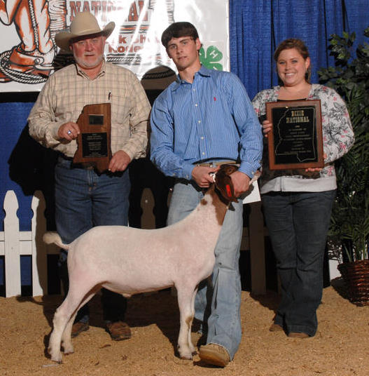
MARKET GOATS
Wash and scrub the goat clean with a mild soap to remove oils from the hair
Blow dry and slick shear with medium or fine blades (depending on finish) from the knee and hock up
Bob and feather the tail
Comb leg hair down and clip legs
Trim hair above hoof and blend

Slide 12
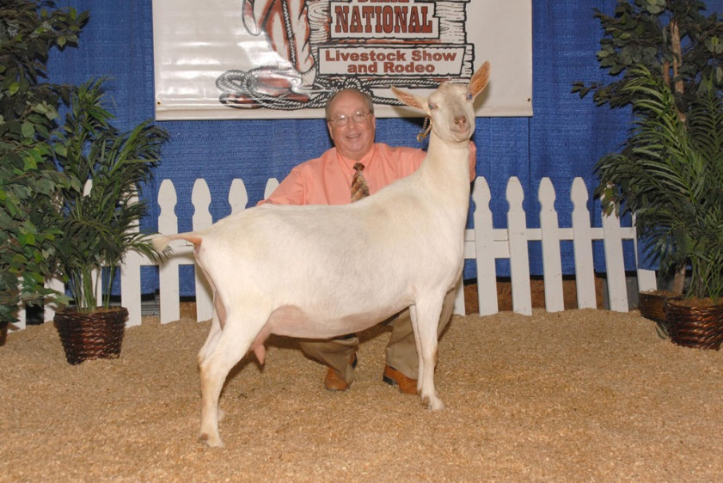
THE REST
Slick shear dairy cattle and dairy goats at least a week out from the show so that any clipper lines will be grown over
Breeding goats will be clipped pretty much the same as breeding cattle
Horses can be slick sheared,
if done properly, but A
shedding blade works better

Slide 13
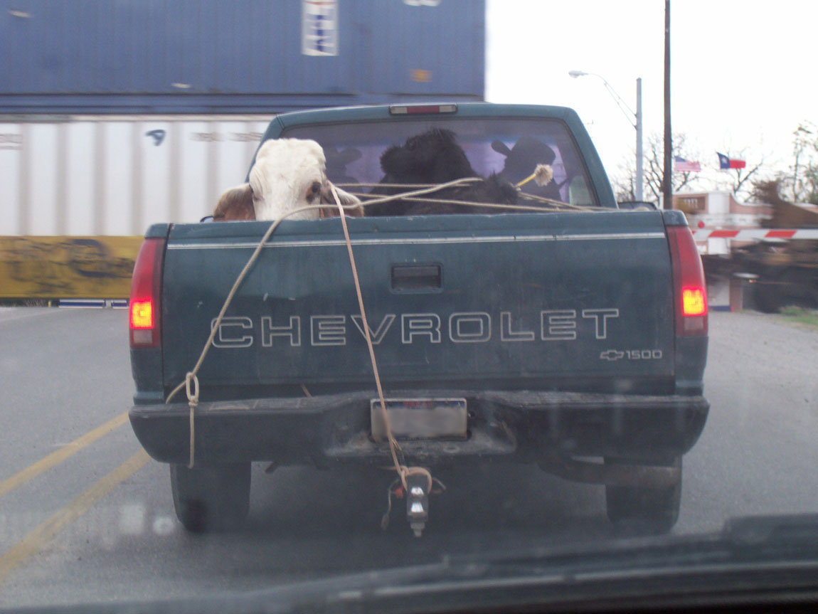
QUESTIONS?

