Slide 1
Extension Agent Guide for Marketing Local Foods
Rachael Carter and Lauren-Colby Lindley

Slide 2
PART 2
Understanding Your Market

Slide 3
Module 1
Market Segments

Slide 4
Identify Market Segments
There are many different segments.
  Age
  Race
  Location
  Income
  Education
Who are you trying to reach?
What product are you offering them?
Notes:
See Developing a Marketing Plan workbook pages 6–7.
There are multiple market segments in the population. A market segment can be divided by race, age, income, education, and many other customer demographics and characteristics. Business owners must determine what customers to try to reach with their product.
It is important to determine what segments to target in order to be efficient in marketing and advertising efforts.
Ask participants to spend 20 minutes filling out the table on page 6.

Slide 5
Existing Data Sources
Census www.census.gov
Bureau of Economic Analysis www.bea.gov
County Business Patterns https://www.census.gov/programs-surveys/cbp.html
Department of Health http://www.msdh.state.ms.us/
ESRI www.esri.com
Department of Revenue http://www.dor.ms.gov/
USDA www.usda.gov
Department of Archives and History www.mdah.ms.gov

Slide 6
Module 2
Evaluating the Market

Slide 7
Assessing the Market
Assess the local market.
Assess local resources.
Interview potential market channels.
Determine prices.
Assess how difficult market entry will be.
Assess your skills.
CAN YOU MAKE A PROFIT?
Notes:
Assess local market – Participants should create a list of possible markets to sell their products. What restaurants, grocery stores, food hubs, or wholesalers are in your region?
Would they be interested in your product? What products are they looking to buy?
Producers should create a list of people at each of these locations to contact and ask if they would be interested in the product. What are their requirements? What is the volume needed and the potential price?
Producers should assess the challenges they would have if selling to each of these potential markets. What skill do they have that would make this viable? What skills or resources do they lack?

Slide 8
Customer Values, Wishes, and Wants
What are your potential customers’ values and characteristics?
How will your product and service meet these needs?
Notes:
In order to have marketing success, business owners need to be able to determine not only demographic information about their customers, but also characteristics such as values, desires, and needs. How will the product you are offering meet these needs? What marketing channel will help reach these customers? Think about what is important to these customers.
For example: Are these potential customers interested in local food because of its health benefits? Do they have families? Do they need tips for preparing your product? What types of television shows do they watch or magazines do they read?

Slide 9
Target Marketing
Identify Target Market
  What group do you want to purchase your product?
Price Sensitivity
  Is your good a luxury good?
  Will your customers be concerned about price?

Slide 10
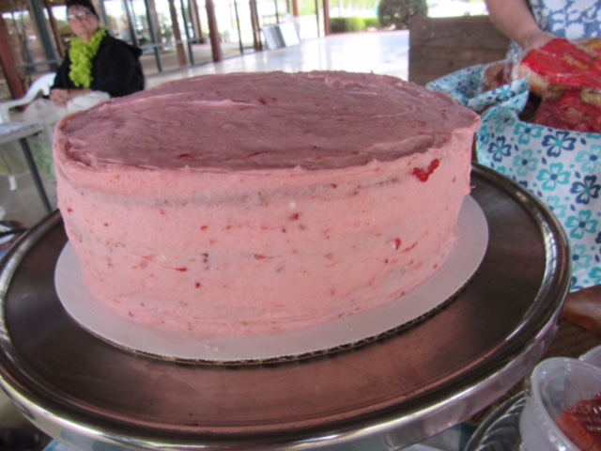
Pricing Strategies
Get top dollar.
Develop a business plan.
Offer packages.
Offer variety.
Know your customers!

Slide 11
Module 3
Brand Identification

Slide 12
Brand Identification
What is unique about your business?
What message are you trying to convey?
What do you want to accomplish?
What experience will you create?

Slide 13
Purpose of Branding
Re-tells the story of a positive experience.
Emphasizes character.
Defines, creates, and implements a system to share your business’s personality.
Ben Muldrow – Arnett Muldrow and Associates
View Branding for Mississippi Agritourism and Local Foods:
https://www.youtube.com/watch?v=jbyBZs1iocg

